Slide 1
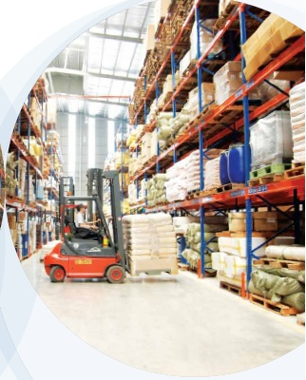
SAIGON NEWPORT CORPORATION
WELCOME TO TAN CANG WAREHOUSING JSC
2013

Slide 2
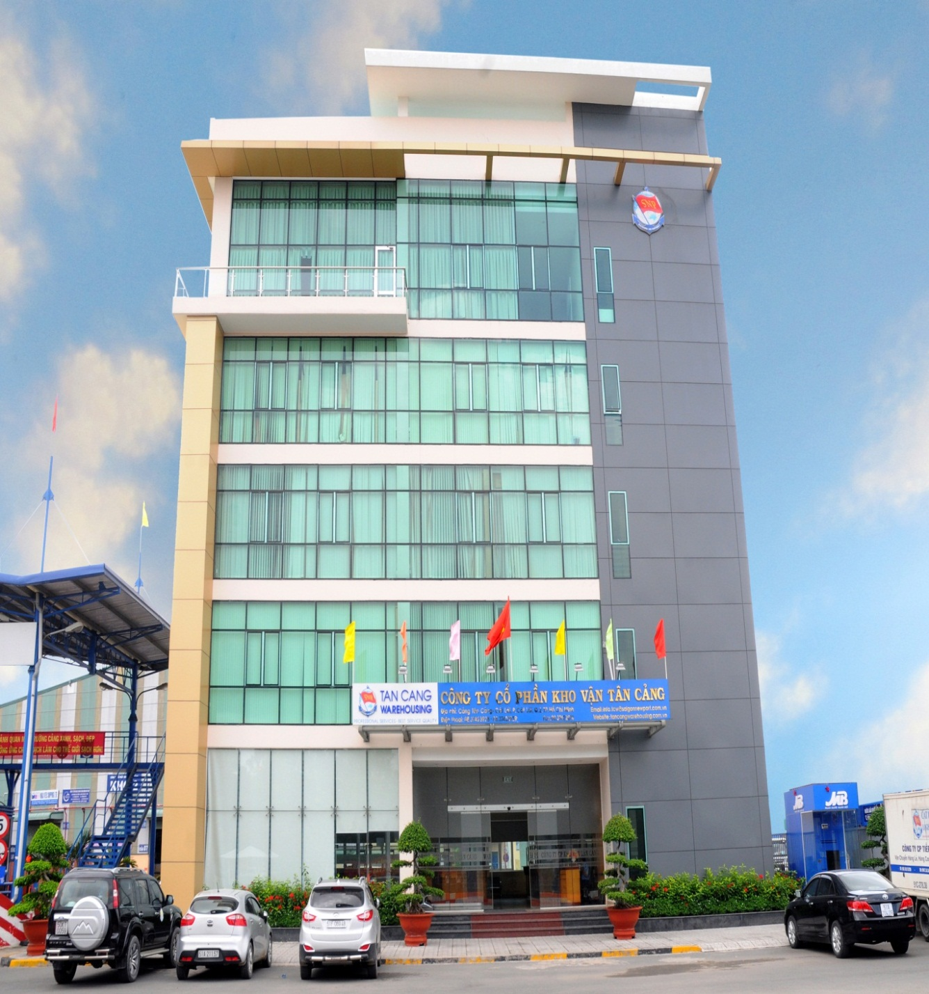
Established: January 4th 2010
TAN CANG WAREHOUSING JSC.
As one of subsidiaries of Saigon Newport Corporation – Vietnam’s People Navy
Location: Tan Cang – Cat Lai Terminal, Cat Lai Ward, Thu Duc City, HCMC, Vietnam.

Slide 3
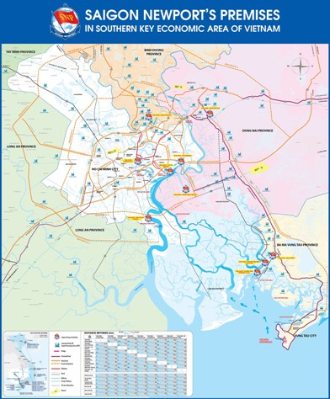
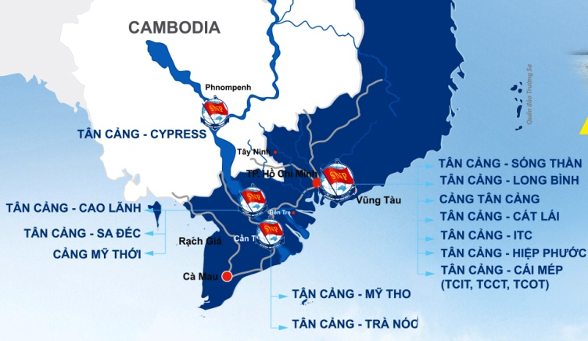
TAN CANG - CAT LAI WAREHOUSE
TAN CANG - CAT LAI WHS

Slide 4
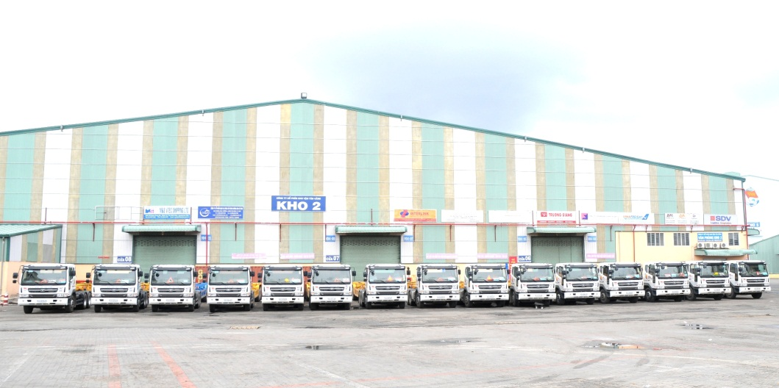
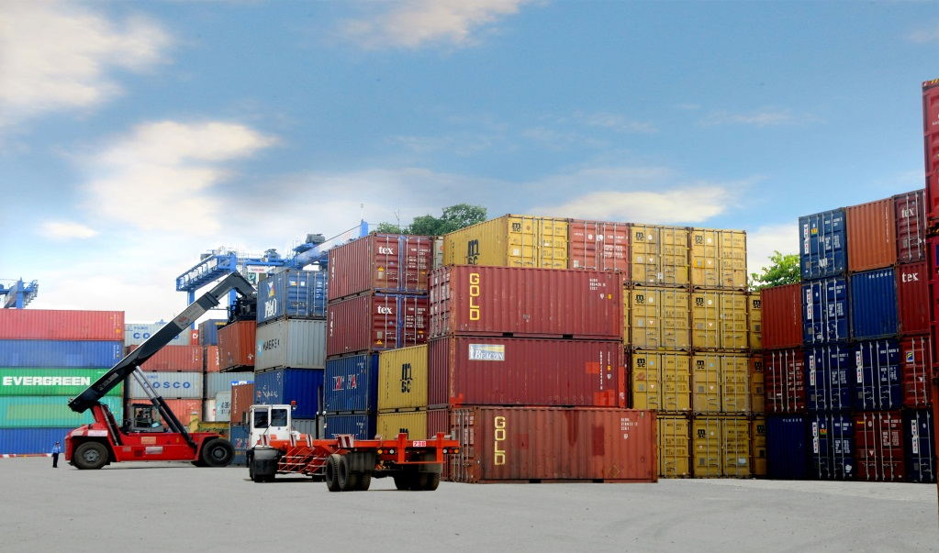
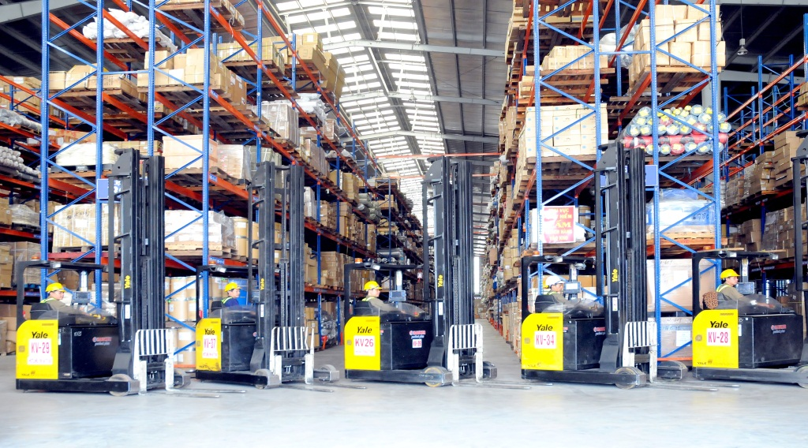
CORE BUSINESSES
WAREHOUSING SERVICE
CFS warehouse
Bonded warehouse
CONTAINER YARD
Stuffing/Un-stuffing service
Container inspection
Fumigation service
DEPOT/ M&R SERVICE
Depot
M&R
TRUCKING SERVICE
Overland trucking HCM and adjacent areas
FCL & LCL trucking
O.O.G trucking

Slide 5
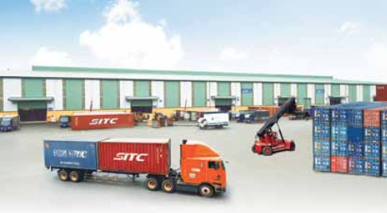
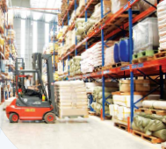
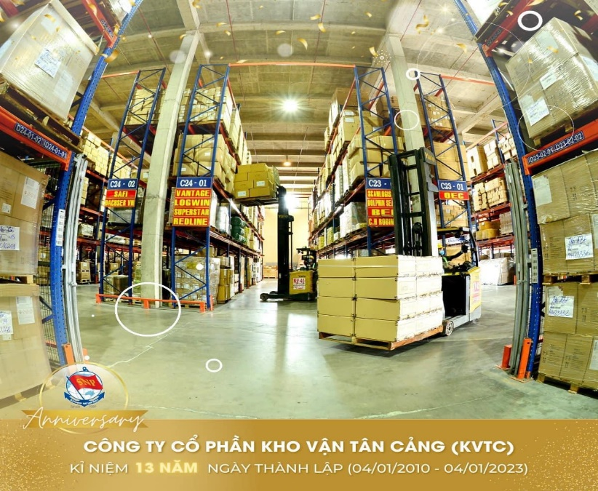
WAREHOUSING SERVICE
Consolidation Freight Station (CFS)
Bonded warehouse

Slide 6
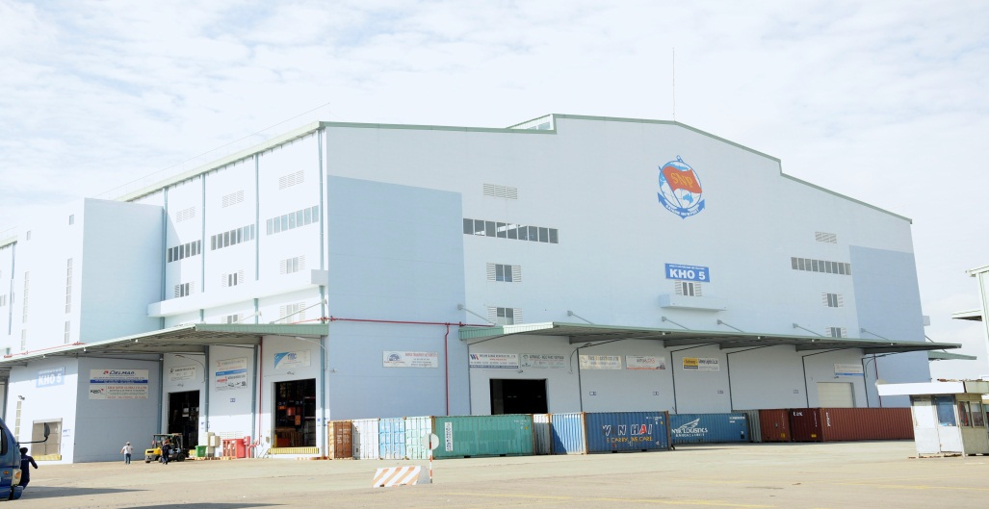
TAN CANG - CAT LAI WAREHOUSE
SCALE & CAPACITY
Total area : 35.500 sqm
18,000 sqm CFS WHS (import) – 12,500 pallets
8,250 sqm CFS WHS (export) – 6,820 pallets
9,250 sqm Bonded WHS – 10,500 pallets
Productivity: 400 containers per day
Handling capacity:
Forklift: 59 battery pcs (indoor) type 2.5MTs
55 diesel pcs (outdoor) type 2.5 - 3.5MTs
Fully equipped with CCTV & Fire fighting system

Slide 7
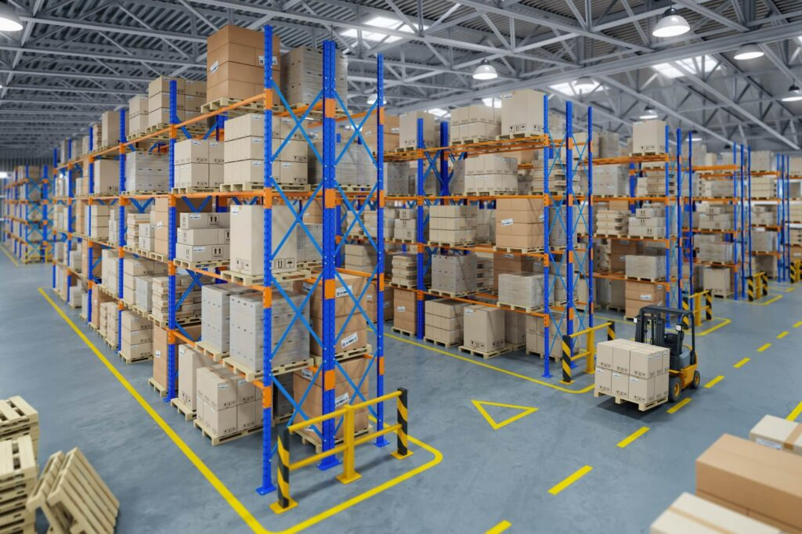
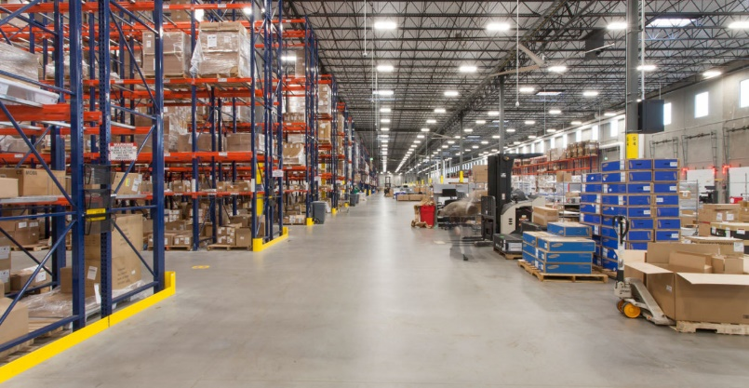
IMPORT CFS WAREHOUSE
Total area: 18,000 sqm
Capacity of 12,500 pallets
Forklift: 64 pcs
32 battery pcs (indoor) – type 2MTs
32 diesel pcs (outdoor) – type 2 - 3.5MTs
CCTV system : 115 pcs, data recorded within 180 days
Racking system: 6 layers
Fully equipped with auto-fire alarm system & sprinkler system
Staff: 116 people per shift (excl. workers)

Slide 8
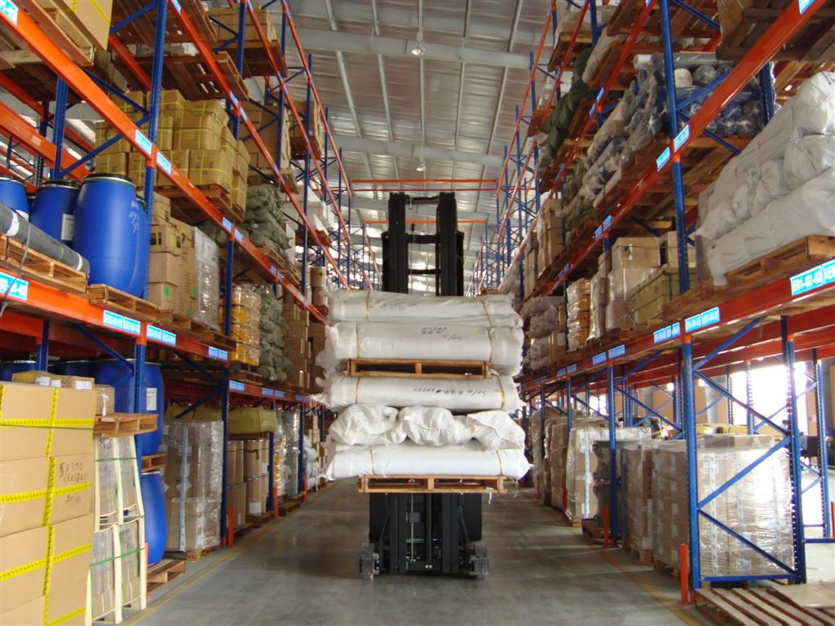
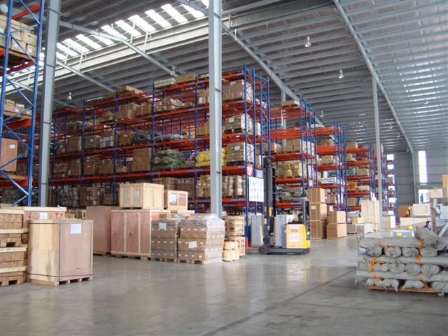
EXPORT CFS WAREHOUSE
Total area: 8,250 sqm
Capacity of 6,820 pallets
Forklift: 46 pcs
23 battery pcs (indoor) – type 2.5 MTs
23 diesel pcs (outdoor) - type 2.5 MTs
CCTV system: 142 pcs (in & out), data recorded within 180 days
Fully equipped with auto-fire alarm system & sprinkler system
Racking system: 5 layers
Staff: 100 people per shift (excl. workers)

Slide 9
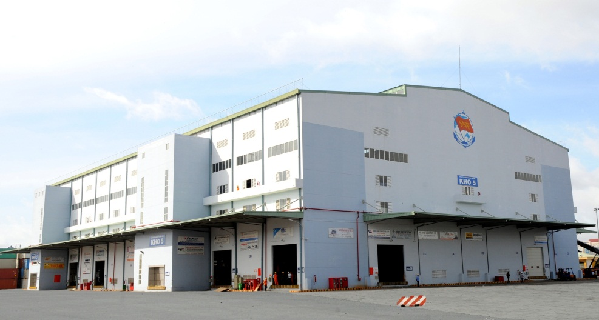
BONDED WAREHOUSE
As a bonded warehouse in an international seaport, it can receive a variety of special goods (wine, beer, tobacco...), diversifying types: import-export goods, transshipment; Save time and cost compared to outside BWH
CCTV: 23 pcs, data recorded within 365 days
Warehouse: “ KNQ TAN CANG SG BQP “
Location: WHS No.5, Tan Cang - Cat Lai Terminal
Total area: 16,350 sqm, in which:
Warehouse area: 9,250 sqm
CY area: 7,000 sqm
Start operation: December 2015

Slide 10
ADVANTAGES OF CAT LAI’S WAREHOUSE
SAFETY for cargos
Handle with best care
Control by CCTV system and patrol
Security commitment
Cost & time saving:
WHS is located inside Cat Lai Terminal, saving time & cost for clients.
Cut-off time is shortened compared to other ICDs outside the port.
WHS staffs are well trained & skillful.
Updated WMS, helping customers save time, costs, ensure safety against Covid-19 epidemic.

Slide 11
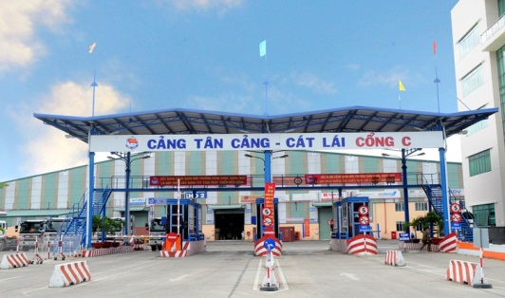
WHS is new built with modern design and well-equipped.
Gate C with 4 lanes is put into operation specifically for trucks less than 15 MTs which help to reduce the traffic jam.
There are various consolidators in the same WHS and it’s easy to co-load the cargoes.
ADVANTAGES OF
CAT LAI’S WAREHOUSE

Slide 12
ADVANTAGES OF WMS-VN
(Warehouse Management System)
Specific racking location and gates designed for each customer => Convenient for operation
Customers are provided with username/password to search the cargo information.
WMS-VN software is applied for managing and controlling cargo information. The customer can track and trace the cargo as requested.
Daily auto-report: cargo receipt, inventory report, etc.
Real-time tracking the status of cargo: registration/ WHS receiving/ container stuffing/ ending process.
Integrate customer’s operation plan into WMS – VN system and work on this software.

Slide 13
EWMS – ELECTRONIC WAREHOUSE MANAGEMENT SYSTEM
Import CFS: Golive September 13, 2021
Export CFS: Golive July 01, 2022
https://ewms.tancangwarehousing.com.vn
Actively creating eDO, e-Booking, creating online import/export note, online payment, etc.)
Minimize direct transactions (Ensure safety against Covid-19)
Convenient transaction
Protect the environment (saving paper)
Proudly being the first warehouse operator to use eDO/eBO in LCL delivery/receive in Vietnam.
Saving costs & time
1
2
3
4
5
6

Slide 14
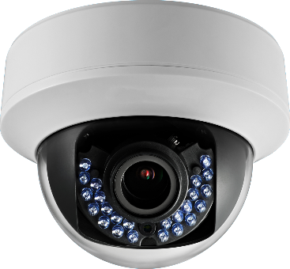
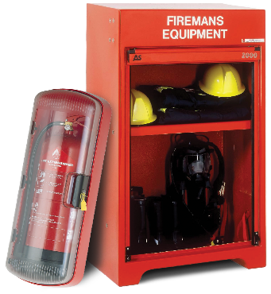
WAREHOUSE SECURITY
CCTV system:
CCTV system are fully equipped with 280 pcs and records are kept within 180 days => Customer can access data for damage/loss occurred.
Burglar alarm system:
Infrared ray burglar alarm system: 57 pcs
Fire fighting system:
Compliance with HCMC Police Department’s Standard
Security guards:
Check at gate, Patrol
Notes:
14

Slide 15
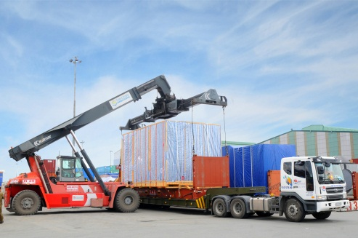
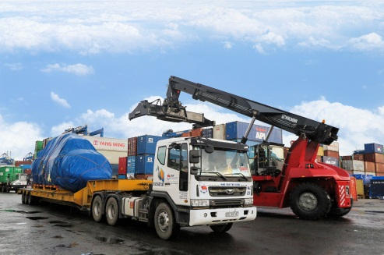
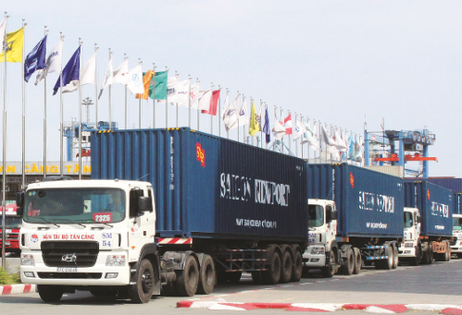
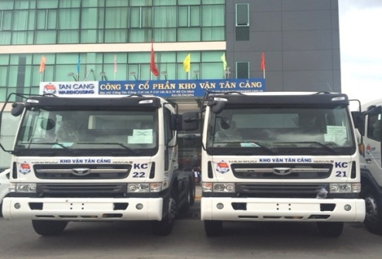
TRUCKING SERVICE
Start operation: April 2015
Truck fleet: 28 prime movers & 72 chassis ( Including O.O.G chassis)
Brand: Huyndai Daewoo
Route: HCMC, Binh Duong, Dong Nai, Mekong Delta, between Ports – Factories
GPS tracking system
Dedicated drivers with FC license
24/7 support
Notes:
15

Slide 16
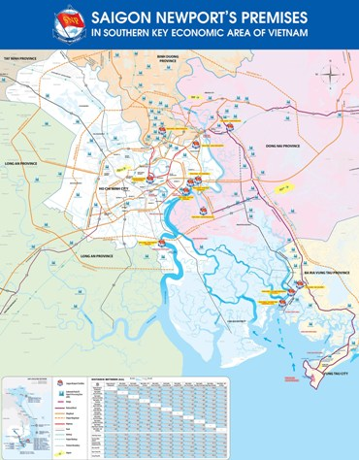
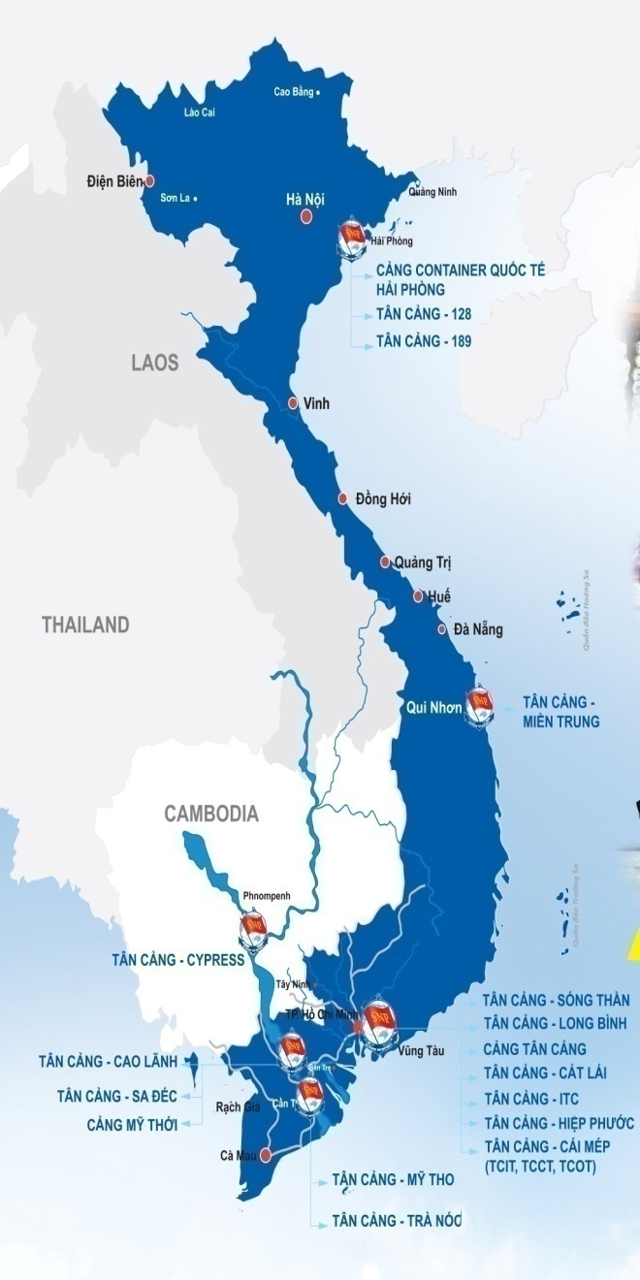
TAN CANG-SUOI TIEN DEPOT
Tan Cang-Suoi Tien Depot
20 Km
Tan Cang-Cat Lai Terminal

Slide 17
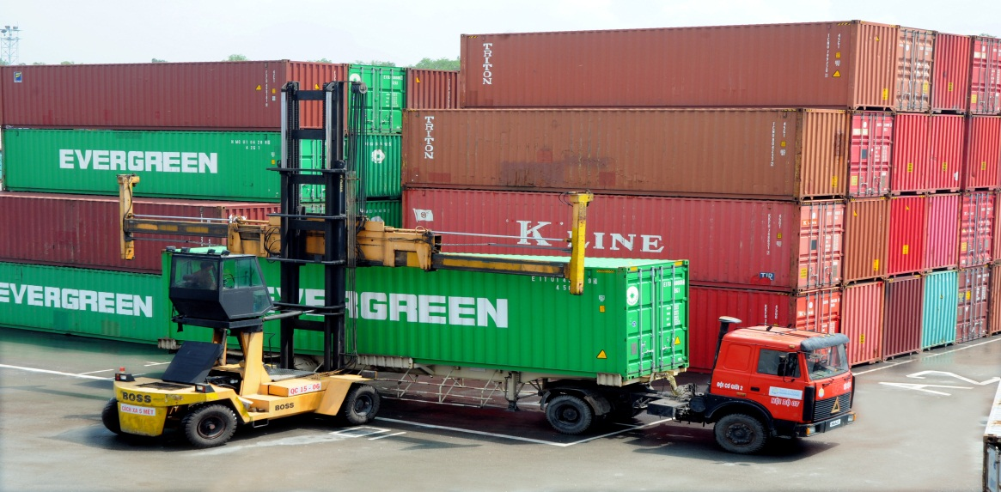
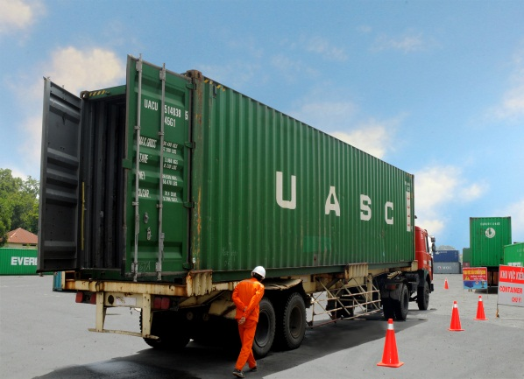
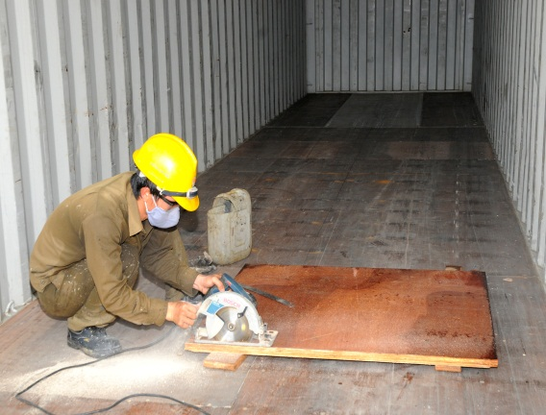
TAN CANG
-
SUOI TIEN DEPOT
Location:
No. 02 Hoang Huu Nam Street., Long Thanh My Ward,Thu Duc City, HCMC.
(Distance from Cat Lai: 19km)
Established: December 2014
Total area: 5 ha (5,500 TEUs) in concrete coverage.
Nominated as the only place to receive damage mty container with cost paid by the Port
Equipment:
+ Management system: TTOS- new software
+ Reach-stacker: 04 pcs (new Kalmar)
+ Prime mover/chassis: 08 pcs
Business activities:
+ M&R (according to IICL-5 standard)
+ Depot

Slide 18
DEPOT LOCATION: SUOI TIEN NEWPORT – PORTS/IPs, EPZs
Address: No. 02 Hoang Huu Nam, Long Thanh My Ward, Thu Duc City, Ho Chi Minh City
Depot distance – Ports, IPs/EPZs (km)
Cat Lai Port | 20
VICT Port | 30
Cai Mep - Thi Vai Port cluster | 60
Amata Industrial Park (Dong Nai) | 8
Nhon Trach Industrial Park (Dong Nai) | 35
Song Than Industrial Park (Binh Duong) | 12
Linh Trung Industrial Park (Thu Duc) | 8
SÓNG THẦN
SÓNG THẦN
AMATA
NHƠN TRẠCH
LINH TRUNG
VICT PORT
CÁT LÁI PORT
CÁI MÉP-THỊ VẢI PORTS

Slide 19
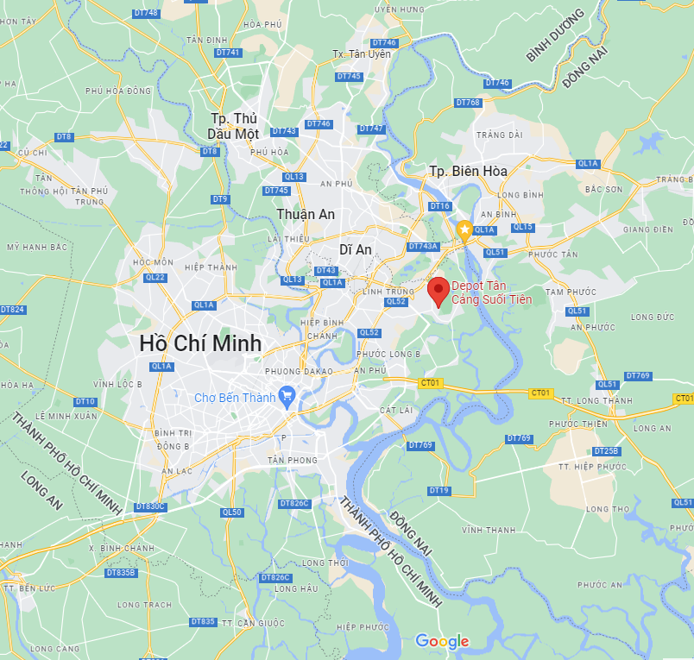
DEPOT LOCATION: SUOI TIEN NEWPORT – PORTS/IPs,EPZs
Depot Distance – Ports, IPs/EPZs (km)
Tân Thuận Export Processing Zone | 30
Tân Tạo Industrial Park | 12
Tân Bình Industrial Park | 13
TC-Hiệp Phước Port | 35
An Phước Industrial Park | 14
Biên Hòa 1,2 Industrial Park | 10
Nhơn Trạch 2 Industrial Park | 4.5
Hitech-Park | 4.5
BIÊN HOÀ
KCX TÂN THUẬN
AN PHƯỚC
TÂN BÌNH
TÂN TẠO
NHƠN TRẠCH
TÂN THUẬN
CNC HITECH PARK
TC-HIỆP PHƯỚC PORT

Slide 20
DEPOT LOCATION: SUOI TIEN NEWPORT – OTHER DEPOTS
Depot Distance from SNP to other depots (Km)
Solog | 15
Vuong Bao Long | 12
Tanamexco | 8
Phuc Long | 8
Transimex | 8
Sotrans | 8
Song Than | 15
Sóng Thần
Solog
Vương Bảo Long
Tana
mexco
Sotrans
Phúc Long
Transimex

Slide 21
TAN CANG WAREHOUSING JSC.
Address: Tan Cang - Cat Lai Port, Cat Lai Ward, Thu Duc City,
Ho Chi Minh City, Vietnam. Tel: +84.8.3742 3928 – 3742 3929; Fax: +84.8.3742 3413
Website:tancangwarehousing.com.vn

